Slide 1
Hi! This is a game of sorts made by Seth Corry.
If you want to play, its simple, just go into presentation mode and then click the button below, that will take you to the “Title Page.” From there its as simple as clicking wherever you want, (some buttons aren't obvious, hence the ‘game’ part of this whole thing).
Hi! I’m a button, click on me in presentation mode and I’ll feel like my life has meaning (and take you to the start of the game).
Click here to go back to Seth’s Website and tell him how much you liked the game!

Slide 2
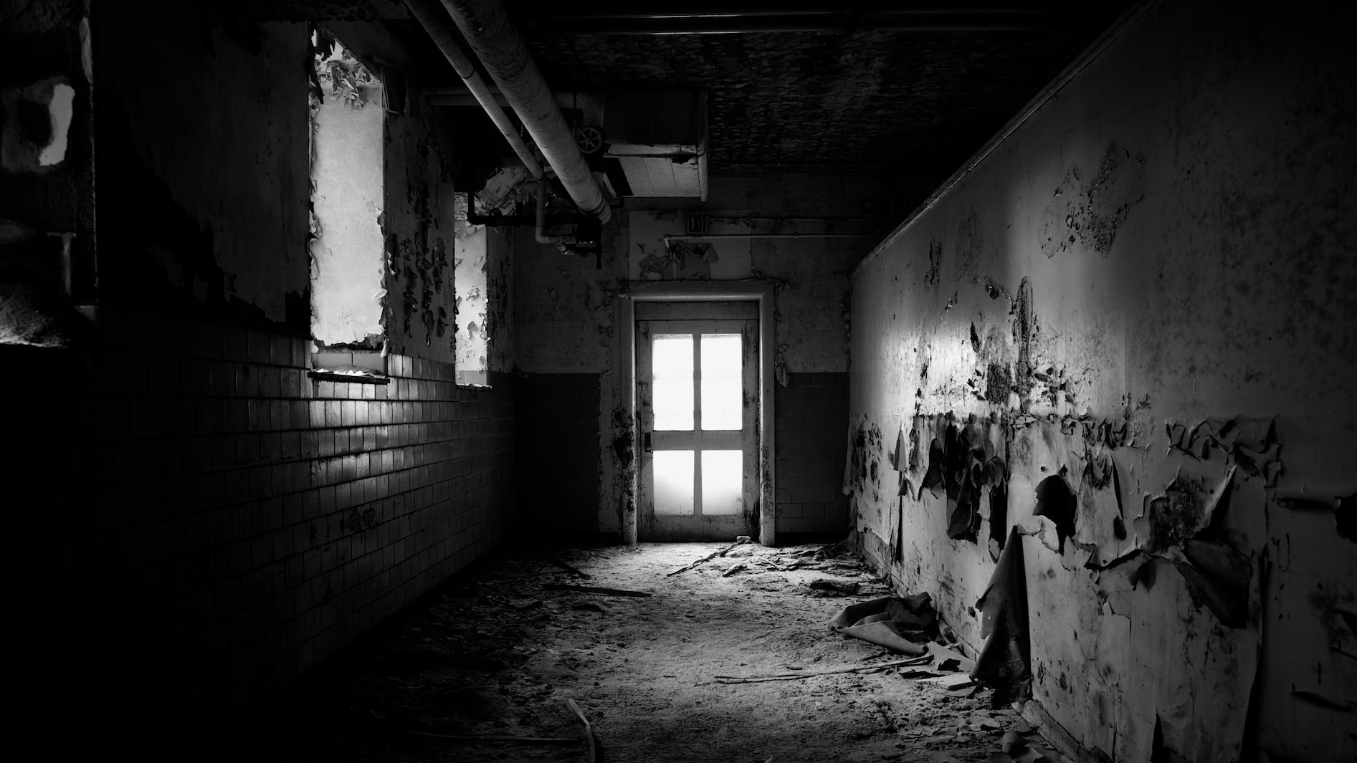
GET OUT
OF THE ROOM
PLAY
PICK ROOM
HOW TO PLAY

Slide 3
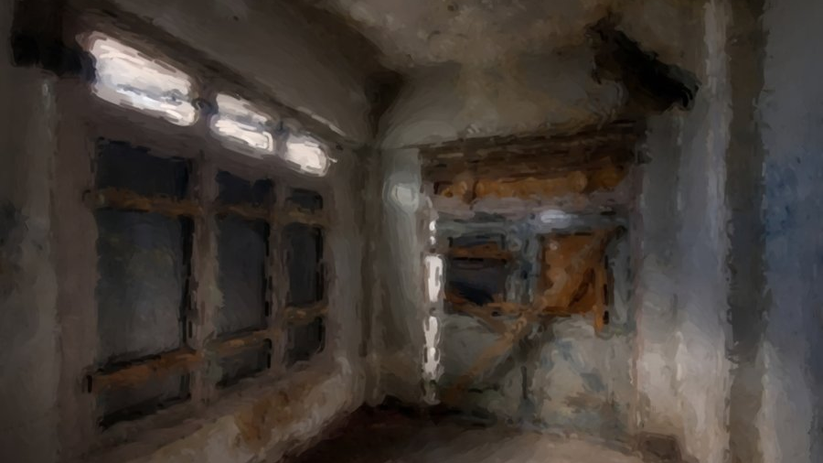

GET OUT
GET ME OUT OF HERE
OF THE ROOM
HOW TO PLAY
It’s Very Simple, GET OUT OF THE ROOM

Slide 4
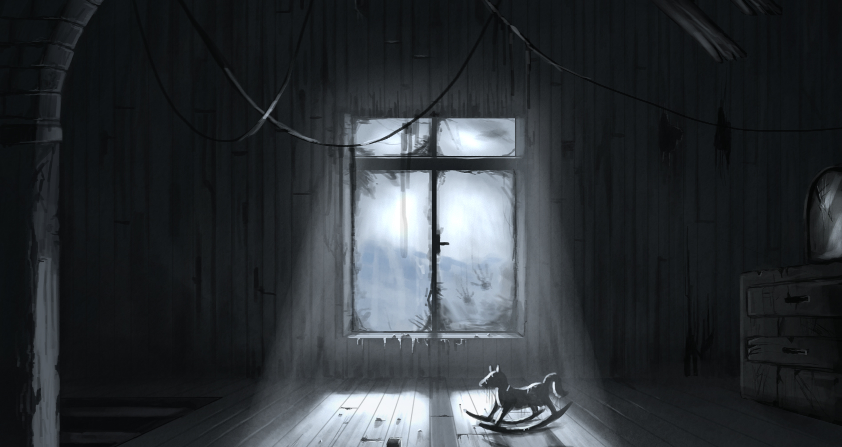
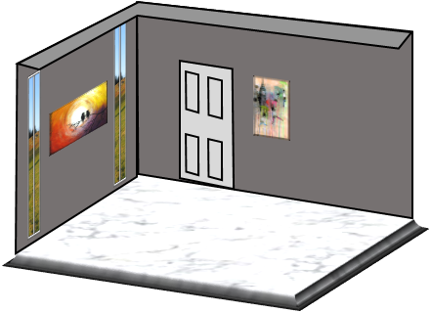

GET OUT
GET ME OUT OF HERE
OF THE ROOM
Choose A Room
ROOM II
ROOM III
ROOM IV
ROOM V
ROOM VI
ROOM VII
ROOM VIII

Slide 5
GET OUT
Are You Sure?
You Want To Continue?
OF THE ROOM
YES! Let Me In There
NO! I Didn’t Mean It! Let Me Go Back!
No....... but let’s do it anyway
PLAY
PICK ROOM
HOW TO PLAY

Slide 7



Move
Left
Right
Back

Slide 8
Move
Left
Right
Back
Next
Oh, Hello There, I did not think that you were going to wake up till later. Mental note to self hit victim harder on back of head. Oh well I have most of it ready anyway.

Slide 9

Move
What Do you Say?
Left
Right
Back
You Sick F***
...........
What Do You Want With Me?

Slide 10
Move
Left
Right
Back
Next
Well Well Well. We are a ummm vary ...... Direct. But I understand. You are mad that kidnaped you just for my own entertainment. I understand. If I were you then I would be mad to.

Slide 11
Move
What Do you Say?
Left
Right
Back
Who The Hell Are You Anyway?
What Do You Want With Me???
.......................
For Your Entertainment?

Slide 12
Move
Left
Right
Back
Next
I don’t really think I should answer that. You see if I were to, you would then most likely go to the police after you get out. Then I would have to deal with the American justice system and well, I’ll just say that it is a pain in the ass.

Slide 13
Move
What Do you Say?
Left
Right
Back
What Do You Want With Me???
.......................
For Your Entertainment?

Slide 14
Move
Left
Right
Back
Next
Well its very Simple, you see I'm not I bad man I want what's in your best interests. There for I want you to get out of this room. Now you also want to get out of this room, at least I think you do. Anyhow what is going to happen is you are going to get out of this room and I’m going to watch you.

Slide 15
Move
Left
Right
Back
Next
So you are most likely thinking “why am I here, who does this voluptuous voice belong to? And I can’t wait to get started what do I do first”

Slide 16
Move
Left
Right
Back
Next
Well.... I cant answer all of them but I can tell you that I want you to get out of here, in fact, that is why you are here in the first place. Its......a kind of a game. You see I watch you and you try to get out of the room.

Slide 17
Move
What Do you Say?
Left
Right
Back
Any thing else I need to know before I start your stupid game
Where do I Start?
No!
.......................

Slide 18
Move
Left
Right
Back
Next
I’m sure if you just look around you will find something that might help you, like the DOOR that might be a good place to start!

Slide 19
Move
Left
Right
Back
Next
Well all I will say is that there are some what helpful clues hidden through out the room. Other the that I would say that you are all good to go!!!

Slide 20
Move
Left
Right
Back
Next
Well to bad. But it is up to you if you don’t want to get out then okay that be cool. I will just cut off your head and mount it in my refrigerator and that way when ever I go to get my calf brain soup I will see you and think oh I’m glad that I was not him. But you know its your choice

Slide 21
Move
Left
Right
Back
Next
Well then.......go on........ get out of the room!

Slide 22
Move
Left
Right
Back

Slide 23
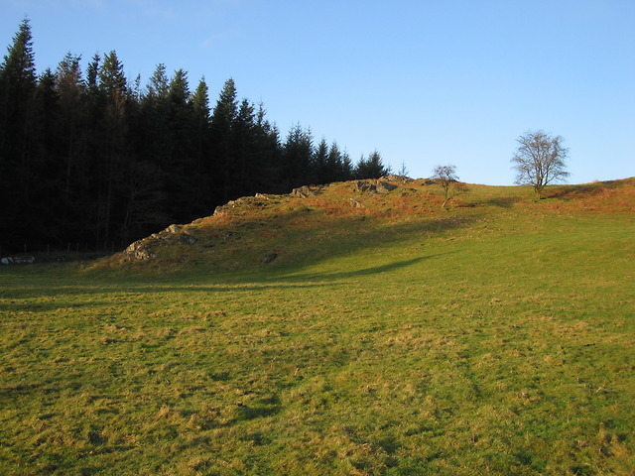


Move
Left
Right
Back

Slide 24

Close
This is a box..... I bet you cant got inside it!

Slide 26
Click To Open
Here
3
2
6

Slide 27
Click To Open
Here
3
2
6
Close
Why Would that work!!!!????!!!!

Slide 28
There is Nothing in Here.... All I wanted was to see if you could get in
Close
WOW I am really impressed. I did not think that you were able to get in...... Good for you!

Slide 29
There is Nothing in Here.... All I wanted was to see if you could get in

Slide 30

Move
Left
Right
Back

Slide 31
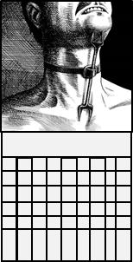
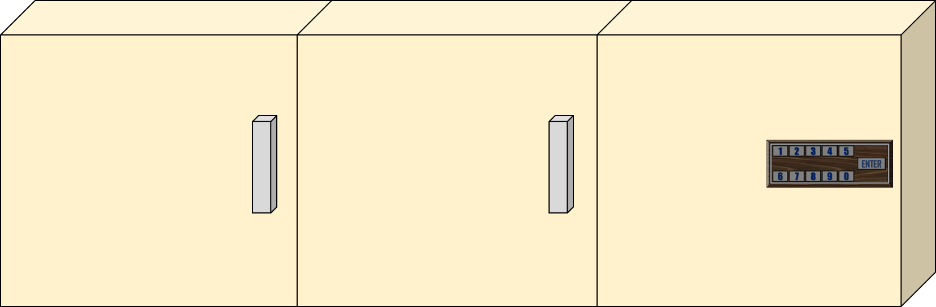


Move
Left
Right
Back

Slide 32
Take a Seat
I want to Leave

Slide 33
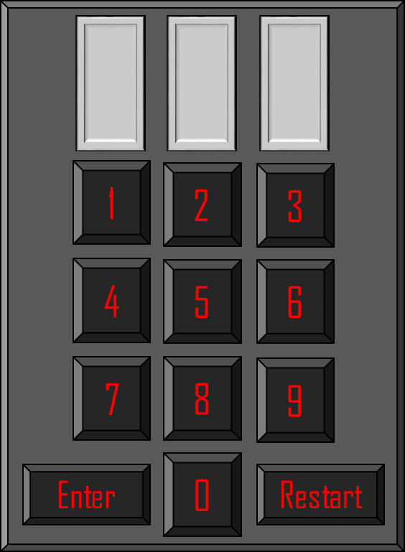

4
Close
What are you doing? You cant rest now! I want to finish! Got UP now!

Slide 34
4

Slide 35


I Don’t like it here anymore
I want to go back

Slide 36
I Don’t like it here anymore
I want to go back
I want to be closer!
Close
I like paintings.

Slide 37
I Don’t like it here anymore
I want to go back
Rotate

Slide 38


I Don’t like it here anymore
I want to go back
Sorry No Clue Here!!! ;)
Rotate
Better Luck Next Time!

Slide 39

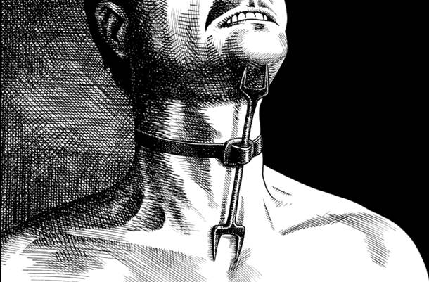

January 1/12
2017
Next
Sunday
1/7
Monday
2/7
Tuesday
3/7
Wednesday
4/7
Thursday
5/7
Friday
6/7
Saturday
7/7
4

Slide 40
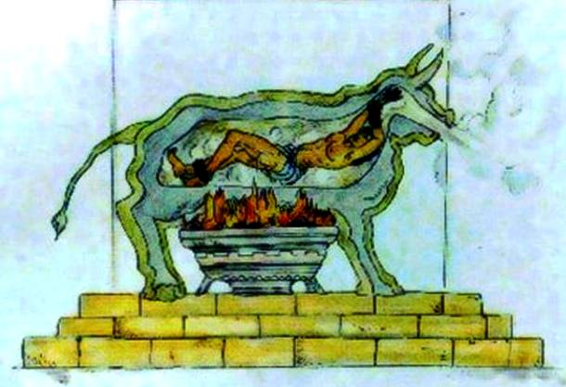
Last
February 2/12
2017
Next
Sunday
1/7
Monday
2/7
Tuesday
3/7
Wednesday
4/7
Thursday
5/7
Friday
6/7
Saturday
7/7
8

Slide 41
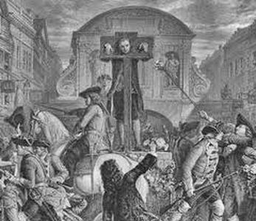
Last
March 3/12
2017
Next
Sunday
1/7
Monday
2/7
Tuesday
3/7
Wednesday
4/7
Thursday
5/7
Friday
6/7
Saturday
7/7
2

Slide 42
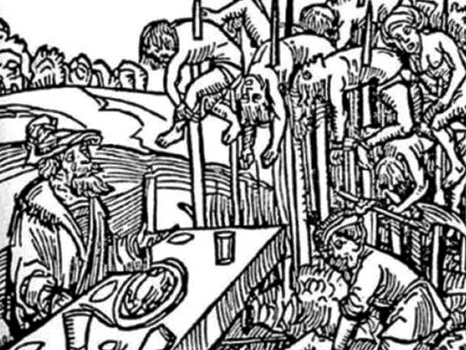
Last
April 4/12
2017
Next
Sunday
1/7
Monday
2/7
Tuesday
3/7
Wednesday
4/7
Thursday
5/7
Friday
6/7
Saturday
7/7
4

Slide 43
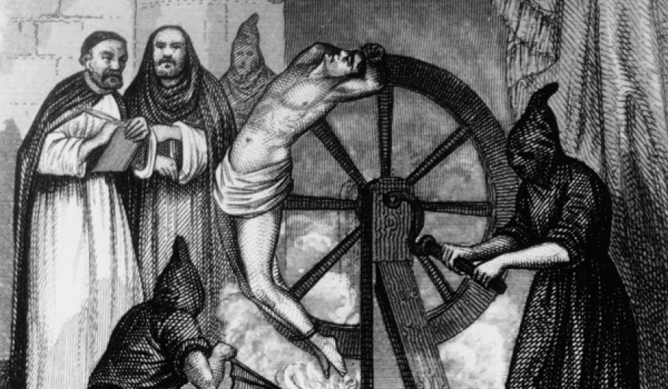
Last
May 5/12
2017
Next
Sunday
1/7
Monday
2/7
Tuesday
3/7
Wednesday
4/7
Thursday
5/7
Friday
6/7
Saturday
7/7
9

Slide 44
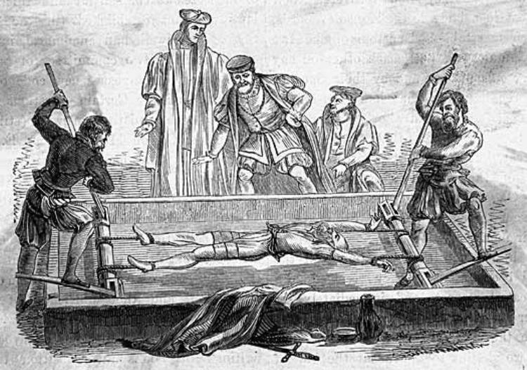
Last
June 6/12
2017
Next
Sunday
1/7
Monday
2/7
Tuesday
3/7
Wednesday
4/7
Thursday
5/7
Friday
6/7
Saturday
7/7
1

Slide 45
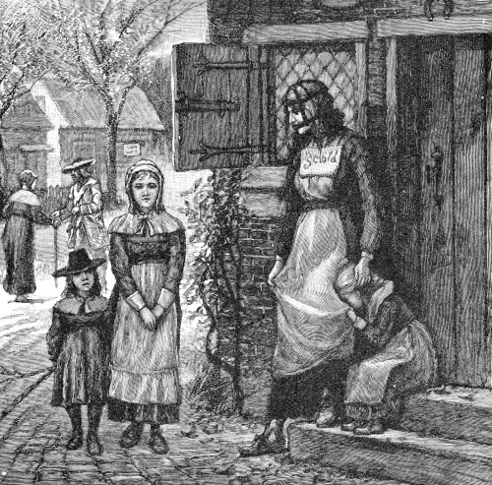

Last
July 7/12
2017
Next
Sunday
1/7
Monday
2/7
Tuesday
3/7
Wednesday
4/7
Thursday
5/7
Friday
6/7
Saturday
7/7
4

Slide 46
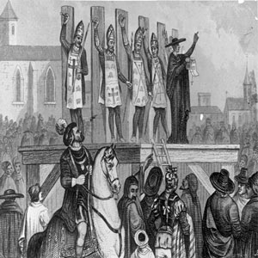
Last
August 8/12
2017
Next
Sunday
1/7
Monday
2/7
Tuesday
3/7
Wednesday
4/7
Thursday
5/7
Friday
6/7
Saturday
7/7
3

Slide 47
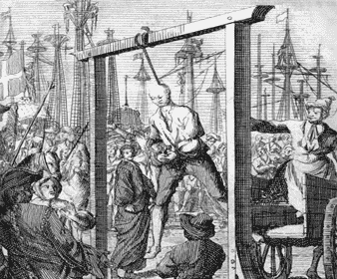
Last
September 9/12
2017
Next
Sunday
1/7
Monday
2/7
Tuesday
3/7
Wednesday
4/7
Thursday
5/7
Friday
6/7
Saturday
7/7
8

Slide 48
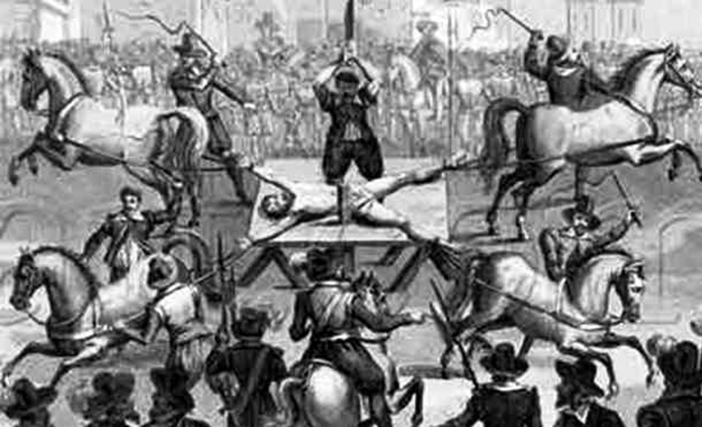
Last
October 10/12
2017
Next
Sunday
1/7
Monday
2/7
Tuesday
3/7
Wednesday
4/7
Thursday
5/7
Friday
6/7
Saturday
7/7
5

Slide 49
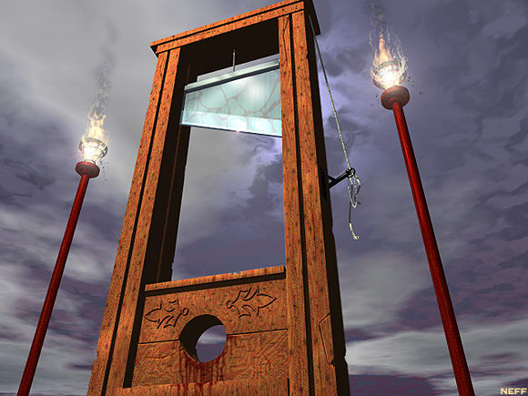
Last
November 11/12
2017
Next
Sunday
1/7
Monday
2/7
Tuesday
3/7
Wednesday
4/7
Thursday
5/7
Friday
6/7
Saturday
7/7
7

Slide 50
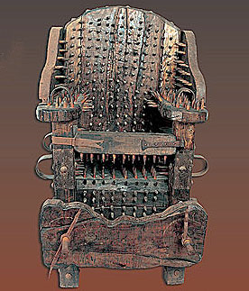
Last
December 12/12
2017
Sunday
1/7
Monday
2/7
Tuesday
3/7
Wednesday
4/7
Thursday
5/7
Friday
6/7
Saturday
7/7
6

Slide 51
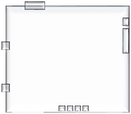
8
4
2
1
Close
Lockers.

Slide 52
8
4
2
1
Close
That is a 8.

Slide 53
8
4
2
1
Close
4.

Slide 54
8
4
2
1
Close
This is a two 2. I would think you wouldn’t need me to tell you that.

Slide 55
8
4
2
1
Close
1. I think, it could be a L though, or a capital I. but considering the circumstances I would say it’s a 1.

Slide 56
8
4
1
4
2

Slide 57
Push
1
2
3
4
5
6
7
8
9
Enter
0
Restart

Slide 58
Push
1
2
3
4
5
6
7
8
9
Enter
0
Restart

Slide 59
Push
1
2
3
4
5
6
7
8
9
Enter
0
Restart

Slide 60
Push
1
2
3
4
5
6
7
8
9
Enter
0
Restart

Slide 61
Push
1
2
3
4
5
6
7
8
9
Enter
0
Restart

Slide 62
Push
1
2
3
4
5
6
7
8
9
Enter
0
Restart

Slide 63
Push
1
2
3
4
5
6
7
8
9
Enter
0
Restart

Slide 64
Push
1
2
3
4
5
6
7
8
9
Enter
0
Restart
Close
Well then I see you have been paying attention.... good for you.

Slide 65
Push
1
2
3
4
5
6
7
8
9
Enter
0
Restart

Slide 66
Push
1
2
3
4
5
6
7
8
9
Enter
0
Restart
Close
No....why would it be that? Try it again.. And do it better

Slide 67
The Wonderful World of Concrete
All 13 books in one addition
The Bricks aren't a pretty set peace, THEY matter!! Don’t think about the bricks...think about the BRICKS....

Slide 68
The Wonderful World of Concrete
All 13 books in one addition
Close
Oh that is one of my old text books. I wondered where it got of to...
The Bricks aren't a pretty set peace, THEY matter!! Don’t think about the bricks...think about the BRICKS....

Slide 69
The Bricks aren't a pretty set peace, THEY matter!! Don’t think about the bricks...think about the BRICKS....
The Wonderful World of Concrete
All 13 books in one addition

Slide 70

Close
Cabinets, I wonder what's in them. Well I mean I don’t wonder what's in them since I know. But you might?

Slide 71
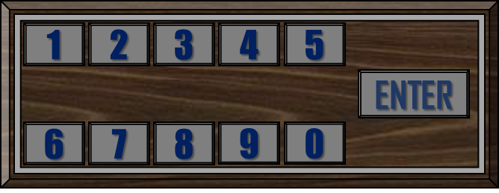

Slide 72

954
291
748

Slide 73
954
291
748
Close
Awww yes.....that was a good day

Slide 74
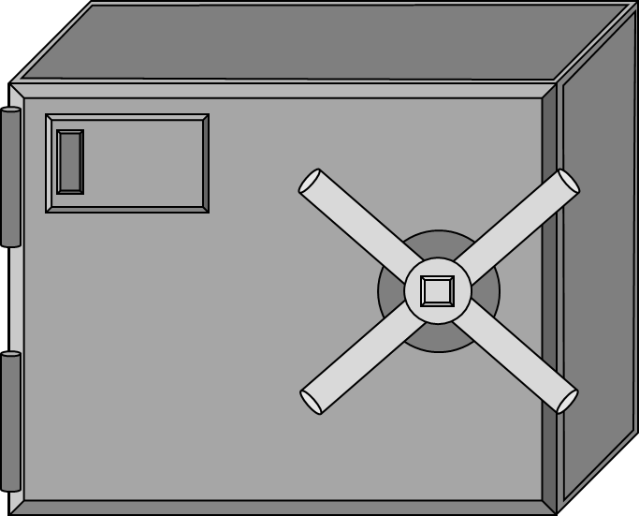

Slide 75
1
2
3
4
5
ENTER
6
7
8
9
0
Close
This one is locked haha. Do you know the right number combination? All you need is 4 numbers. You can do it.

Slide 76
1
2
3
4
5
ENTER
6
7
8
9
0

Slide 77
1
2
3
4
5
ENTER
6
7
8
9
0
Close
Oh come on it is more complicated then that

Slide 78
1
2
3
4
5
ENTER
6
7
8
9
0

Slide 79
1
2
3
4
5
ENTER
6
7
8
9
0
Close
I thought is was quit simple, maybe not?

Slide 80
1
2
3
4
5
ENTER
6
7
8
9
0

Slide 81
1
2
3
4
5
ENTER
6
7
8
9
0
Close
I would love to give you a hint, but.....where's the fun in that?

Slide 82
1
2
3
4
5
ENTER
6
7
8
9
0

Slide 83
1
2
3
4
5
ENTER
6
7
8
9
0
Close
Wow I think that you may be in here for a while

Slide 84
1
2
3
4
5
ENTER
6
7
8
9
0

Slide 85

12
12
3
3
The Locker Combination is in the other cabinet.
Lock e’m Up
The step by step hand book for building your own indoor prison sell
They Wont Step Talking:
how to make the voices in your head go away
The Big Book Of Barbed Wire
6
6
Close
You did it! now tell me, that was not to hard was it? Anyway I don’t know if any of the things in here will help you. So I don’t really know why you wanted to get in here in the first place.
9
9

Slide 86
12
12
3
3
The Locker Combination is in the other cabinet.
Lock e’m Up
The step by step hand book for building your own indoor prison sell
They Wont Step Talking:
how to make the voices in your head go away
The Big Book Of Barbed Wire
6
6
9
9

Slide 87
12
12
3
3
The Locker Combination is in the other cabinet.
Lock e’m Up
The step by step hand book for building your own indoor prison sell
They Wont Step Talking:
how to make the voices in your head go away
The Big Book Of Barbed Wire
6
6
Close
You know, I got this book thinking that it would help with my ummm....how should I put it......my problem, and THEY say it did, however, I am still not convinced
9
9

Slide 88
12
12
3
3
The Locker Combination is in the other cabinet.
Lock e’m Up
The step by step hand book for building your own indoor prison sell
They Wont Step Talking:
how to make the voices in your head go away
The Big Book Of Barbed Wire
6
6
Close
You my not know this but, a lot more goes into what I do then you might think. There are sooooo many little things that I have to do in order to make every little detail have a purpose. Its so tiring!
9
9

Slide 89
12
3
The Locker Combination is in the other cabinet.
Lock e’m Up
The step by step hand book for building your own indoor prison sell
They Wont Step Talking:
how to make the voices in your head go away
The Big Book Of Barbed Wire
6
Close
The Photography in that one is amazing! The way the light bounces of the wire is...........beautiful!
9

Slide 90
12
12
3
3
The Locker Combination is in the other cabinet.
Lock e’m Up
The step by step hand book for building your own indoor prison sell
They Wont Step Talking:
how to make the voices in your head go away
The Big Book Of Barbed Wire
6
6
Close
I’m not talking to you about those numbers if they mean anything then you should find that out on your own, with out me.
9
9

Slide 92
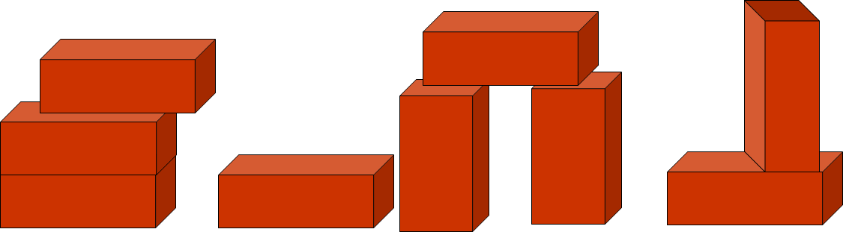


Slide 93
Close
It’s a shelf.

Slide 94
Close
There is nothing interesting about this shelf. Stay focused!

Slide 95
Close
Just because you can click something does not mean it has anything to do with the rest of the game.

Slide 96
Close
Oh my Gosh! Stop it!

Slide 97
Close
If you click that shelf one more time then I’m not talking to you any more.

Slide 98
Close
.........

Slide 99
Close
There.......................Bricks, I wonder why they are in this strange pattern? It could be a clue..........or not, who knows? You most certainly don’t! or do you?

Slide 100

I want to be closer!
Close
Aww I see you like this painting, you know this is one my favorite painting, because it has owls... I LOVE owls.

Slide 102
Rotate

Slide 103

Moose
Owl
Dog
Cat
Chicken
Rat
Rotate
2
Eagle
1
Eel
4
Crow
3
Slug
2
4
5
3
1
5

Slide 104


1
2
3
4
5
DOOR STATUSE.... LOCKED
6
7
8
9
0
PRESS HERE TO RESTART
I Don’t like it here anymore
I want to go back
Close
Ah you are so close to getting out of the room! All you need to do is find the right four digit code, that’s all. That is not to hard, is it?

Slide 105
1
2
3
4
5
DOOR STATUSE.... LOCKED
6
7
8
9
0
PRESS HERE TO RESTART
I Don’t like it here anymore
I want to go back

Slide 106
1
2
3
4
5
DOOR STATUSE.... LOCKED
6
7
8
9
0
PRESS HERE TO RESTART
I Don’t like it here anymore
I want to go back
Close
Oh come on!! Even I knew that was wrong!! Get Good! Gosh!

Slide 107
1
2
3
4
5
DOOR STATUSE.... LOCKED
6
7
8
9
0
PRESS HERE TO RESTART
I Don’t like it here anymore
I want to go back

Slide 108
1
2
3
4
5
DOOR STATUSE.... LOCKED
6
7
8
9
0
PRESS HERE TO RESTART
I Don’t like it here anymore
I want to go back

Slide 109
1
2
3
4
5
DOOR STATUSE.... LOCKED
6
7
8
9
0
PRESS HERE TO RESTART
I Don’t like it here anymore
I want to go back

Slide 110
1
2
3
4
5
DOOR STATUSE.... LOCKED
6
7
8
9
0
PRESS HERE TO RESTART
I Don’t like it here anymore
I want to go back
Close
Sooo, you think this is it? Well then lets find out....

Slide 111
1
2
3
4
5
DOOR STATUSE.... LOCKED
6
7
8
9
0
PRESS HERE TO RESTART
I Don’t like it here anymore
I want to go back

Slide 112
1
2
3
4
5
DOOR STATUSE.... LOCKED
6
7
8
9
0
PRESS HERE TO RESTART
I Don’t like it here anymore
I want to go back

Slide 113
1
2
3
4
5
DOOR STATUSE.... LOCKED
6
7
8
9
0
PRESS HERE TO RESTART
I Don’t like it here anymore
I want to go back

Slide 114
1
2
3
4
5
DOOR STATUSE.... LOCKED
6
7
8
9
0
PRESS HERE TO RESTART
I Don’t like it here anymore
I want to go back

Slide 115
1
2
3
4
5
DOOR STATUSE.... LOCKED
6
7
8
9
0
PRESS HERE TO RESTART
I Don’t like it here anymore
I want to go back
Close
Sooo, you think this is it? Well then lets find out....

Slide 117
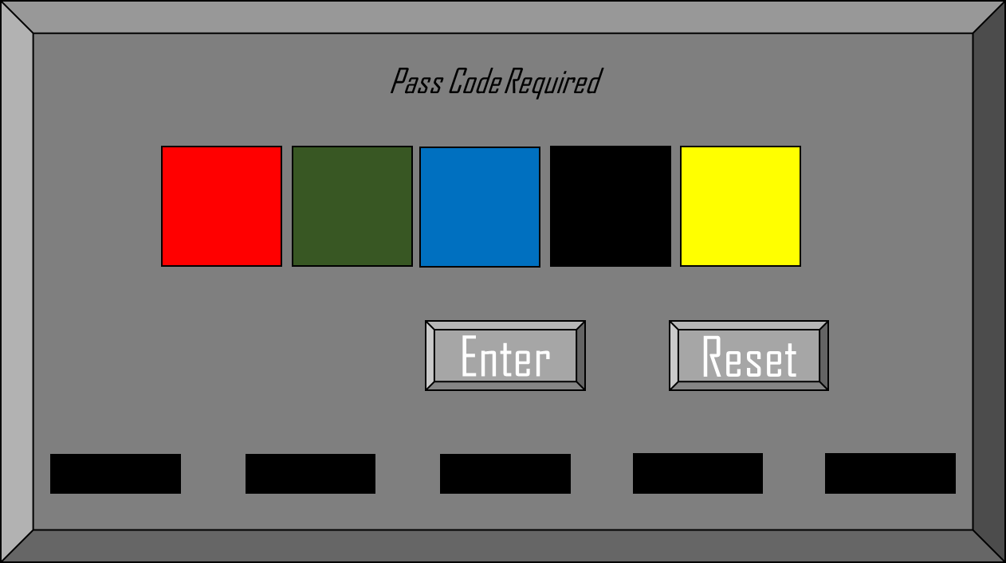

Slide 118
Pass Code Required
Enter
Reset

Slide 119
Pass Code Required
Enter
Reset

Slide 120
Pass Code Required
Enter
Reset

Slide 121
Pass Code Required
Enter
Reset

Slide 122
Pass Code Required
Enter
Reset

Slide 123
Pass Code Required
Enter
Reset
OOO can’t wait to see if it works!

Slide 124
Pass Code Required
Enter
Reset
Close
Not Even Close!

Slide 125
Pass Code Required
Enter
Reset

Slide 126
Pass Code Required
Enter
Reset

Slide 127
Pass Code Required
Enter
Reset

Slide 128
Pass Code Required
Enter
Reset

Slide 129
Pass Code Required
Enter
Reset

Slide 131
The Calendar has extra numbers for a reason!! And the calendar is used twice!!

Slide 132
The Calendar has extra numbers for a reason!! And the calendar is used twice!!

Slide 133

GET ME OUT OF HERE
You DID it Good for you. Well almost.....you see I have one final thing for you. All you need to do is find the right door pattern to get out. Think of it like a maze!!

Slide 134
Move
Left
Right
4
1
2
3
Back
Back

Slide 135
1
2
3
4
Back

Slide 136
1
2
3
4
Back

Slide 137
1
2
3
4
Back

Slide 138
1
2
3
4
Back

Slide 139
1
2
3
4
Back

Slide 140
1
2
3
4
Back

Slide 141
Exit
This Is SOOOO Not A TRAP
Close
YOU DID IT!! And I mean it this time... Now go on leave you have earned it!
Back

Slide 142
Exit
This Is SOOOO Not A TRAP
Back

Slide 143
Except This Ending
Close
I think you made a wrong turn some where....oops
Back

Slide 144
Except This Ending
Back

Slide 145
YOU DID IT!!! GOOD FOR YOU!!!!
PS. THIS IS THE GOOD ENDING
Click here to go back to Seth’s Website and tell him how much you liked the game!
Leave

Slide 146
Oh...........That was “A way” to get out.....
PS. THIS IS THE BAD ENDING
Click here to go back to Seth’s Website and tell him how much you liked the game!
Leave

Slide 147





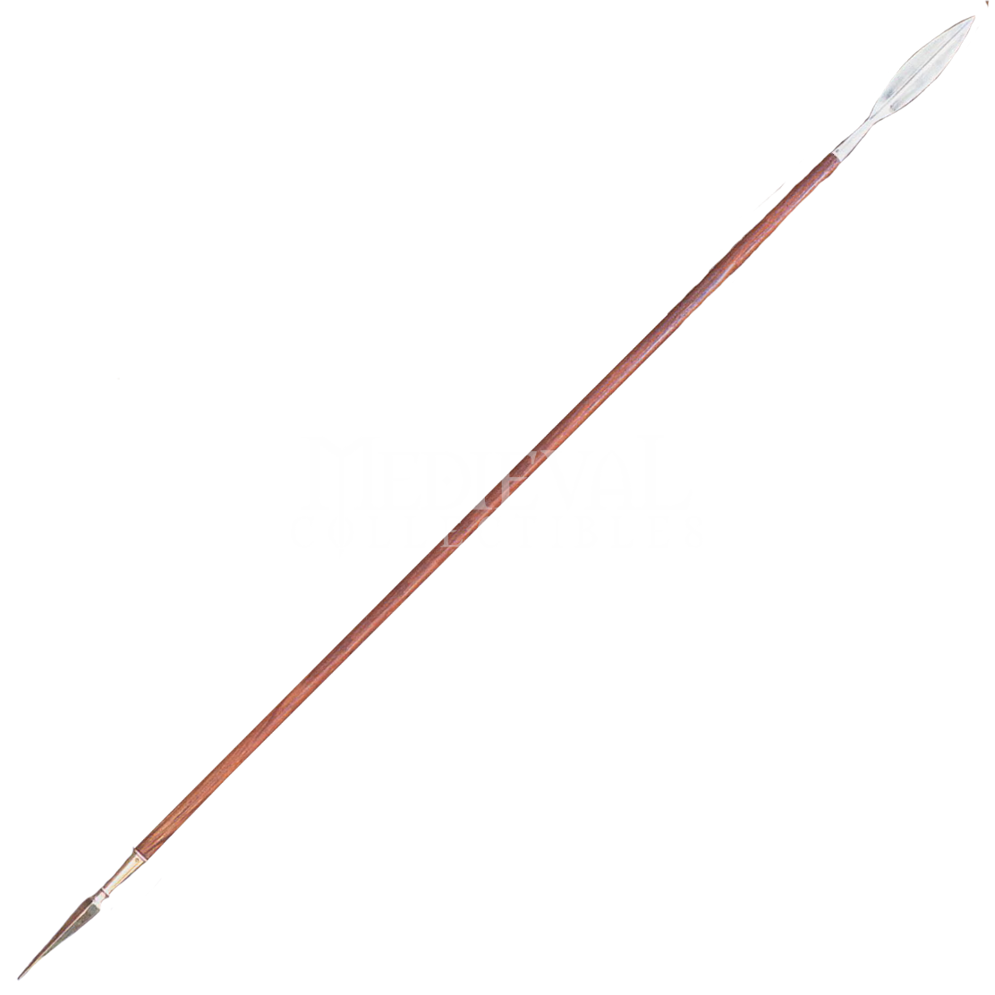
Heads Up!
The Official 2011
Head Hunters Convention
ROOM I
Move
Left
Right
Back

